Slide 1
PMG 4101: Project Management
Syed Samin Sadaf
Lecturer
Department of CSE,
United International University (UIU)

Slide 2
Introduction
Computer hardware, software, networks, and the use of interdisciplinary and global work teams have radically changed the work environment.
Organizations waste $97 million for every $1 billion spent on projects, according to PMI’s Pulse of the Profession® report. Many people and organizations today have a new or renewed interest in project management to improve team-work, problem-solving, and verbal communications.
The Project Management Institute (PMI) reported that the number of jobs reached almost 66 million in 2017. By 2027, employers will need 87.7 million individuals working in project management–oriented roles.
In 2017, the average annual salary (without bonuses) for someone in the project management profession was $112,000 in the U.S. and $130,866 in Switzerland

Slide 3
Introduction
Main questions are
What is project?
What is Software project?
What is software project management? Is it really different from ordinary’ project management?
How do you know when a project has been successful?

Slide 4
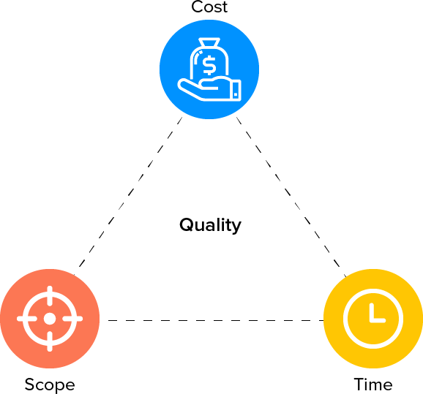
What is a Project?
A series of Activities: To accomplish the specific Goal/Scope, within a limited Timeframe, within a specific Budget and maintaining the desired Quality

Slide 5
Project
A project is a temporary endeavor undertaken to create a unique product, service, or result.
Temporary endeavor:
indicates that a project has a definite beginning and end.
does not necessarily mean a project has a short duration.
Projects are temporary, but their deliverables may exist beyond the end of the project.
Unique product, service, or result:
Projects are undertaken to fulfill objectives by producing deliverables.
Fulfillment of project objectives may produce one or more of the following deliverables:
A unique product that can be either a component or another item
A unique service (e.g., a business function that supports production or distribution)
A unique result, such as an outcome or document (e.g., a research project that develops knowledge that can be used to determine whether a trend exists or a new process will benefit society)
A unique combination of one or more products, services, or results (e.g., a software application, its associated documentation, and help desk services)

Slide 6


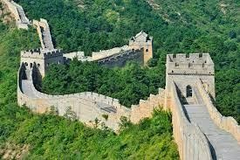
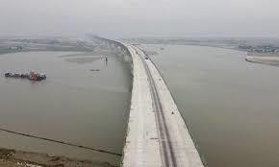



Project
Pyramids
Taj Mahal
Great Wall of China
Padma Bridge
Human landing on moon
Samsung Gear 360
BB1 satellite launching
Outcomes of these projects were the result of leaders and managers applying project management practices, principles, processes, tools, and techniques to their work.
The managers of these projects used a set of key skills and applied knowledge to satisfy their customers and other people involved in and affected by the project.

Slide 7
Operation vs Project
A project is not a routine operation, but a specific set of operations designed to accomplish a singular goal.
Operation is an organizational function performing the ongoing execution of activities that produce the same product or provide a continuous and repetitive service.
Aspect | Project | Operation
Definition | A temporary endeavor to create a unique product, service, or result | Ongoing and repetitive activities that produce the same result repeatedly
Duration | Definite start and end | Without a defined end
Objective | To change | To sustain and maintain
Outcome | Unique output | Repetitive outputs or services
Resources | Temporarily assigned | Permanent/stable resource structure

Slide 8
Exercise
Details | Operation | Project
A team of students creates a smartphone application and sells it online
A company is planning enough hardware capacity and servers for the applications to run smoothly
A company develops a driverless car
A college upgrades its technology infrastructure to provide wireless Internet access across the whole campus as well as online access to all academic and student service information.
A government group develops a system to track child immunizations
Ensuring Microsoft Teams/Zoom/Google Meet meetings are up and running with the correct setting for DataLab software company
A large network of healthcare providers updates its information systems and procedures.
A global bank acquires other financial institutions and needs to consolidate systems and procedures
DataLab software stores securely data about the business for data analysts

Slide 9

What is Management?
Management can be defined as all activities and tasks undertaken by one or more persons for the purpose of planning and controlling the activities of others in order to achieve/complete objectives.

Slide 10
Management Functions
Planning
Predetermining a course of action for accomplishing organizational Objectives
Organizing
Arranging the relationships among work units for accomplishment of objectives and the granting of responsibility and authority to obtain those objectives
Staffing
Selecting and training people for positions in the organization
Directing
Creating an atmosphere that will assist and motivate people to achieve desired end results
Controlling
Establishing, measuring, and evaluating performance of activities toward planned
objectives

Slide 11
Costs of Poor Management
Client dissatisfaction
Late delivery and communication
Poor quality
Inability to plan
Staff dissatisfaction
Frustration
Impact on family and personal life
Waste of precious resources

Slide 12
Software project
A software project is an organized set of activities carried out to create a software application or system that meets user needs.
A software project uses:
People (developers, testers, managers)
Processes (Agile, Waterfall, Scrum)
Tools (IDEs, version control, testing tools)
-to make sure the software is delivered correctly, efficiently, and within constraints.

Slide 13
Examples of Software Projects
1. Mobile Application Development:
Creating a food delivery app like Foodpanda. Activities include UI design, backend development, API integration, testing, etc.
2. Website Development Project:
Building an e-commerce website.
3. Software Upgrade Project:
Updating an old banking system to a newer version. Involves migrating data, updating security features, etc.
4. Automation System
Building a library management system for a university. Includes modules for issuing books, tracking fines, managing users.
5. Game Development Project
Developing a 3D racing game. Requires graphics design, physics programming, audio integration, and testing.
6. AI/ML-Based Software Project
Creating a spam email detection system. Requires collecting data, training models, writing algorithms, and integrating the model into an application.

Slide 14
SW Project vs Other Project
The product of software project have certain characteristics which make them different.
Invisibility: When a physical artifact such a bridge or road is being constructed the progress being made can actually be seen. With software, progress may not immediately visible.
Complexity: Per dollar, pound or euro spent, software products contain more complexity than other engineered artifacts.
Conformity: The traditional engineer is usually working with physical systems and physical materials like cement and steel. These systems can have some complexity but are governed by physical laws that are consistent. Software developers have to confirm to the requirements of human clients that certainly keeps on fluctuating.
Flexibility: The ease with which software can be changed is usually seen as one of its strengths. Software systems are subject to a high degree of change.

Slide 15
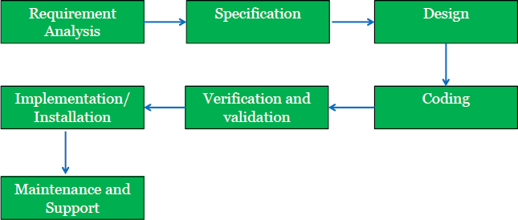
SW Project Development Life Cycle - SDLC

Slide 16
Software Project Management

Slide 17
SMART criteria in Project Management
SMART refers to criteria for setting goals and objectives. The idea is that every project goal must adhere to the SMART criteria to be effective. Therefore, while planning a project’s objectives, each one should be :
Specific
Measurable
Attainable
Relevant
Time bound

Slide 18
Software Project Management
What is software
project management?
Common problems with software projects
Lack of quality standards and measures
Lack of measurable milestones
Difficult to make the progress visible
Poor communications & documentation
Frequent changes of requirements
Over budget and late delivery of software
Understand the characteristics of software products
Understand what is meant by a project
Understand what is meant by
management

Slide 19
Why Software Project Management (SPM) ?
American failure experience for not following SPM
25% of development projects are abandoned
Probability of cancellation rises to 50% for largest developments
Average project overshoots schedule by 50%
75% of systems are regarded as ‘operating failures’
- U.S. Bureau of Labor Statistics, 1997

Slide 20
Why Software Project Management (SPM) ?
Maintenance is the most expensive phase and coding is the least expensive phase
The earlier the detection of faults, the less expensive the correction of faults
A good slogan:
You may not be able to avoid making mistakes … But you must find them before they cost too much!

Slide 22
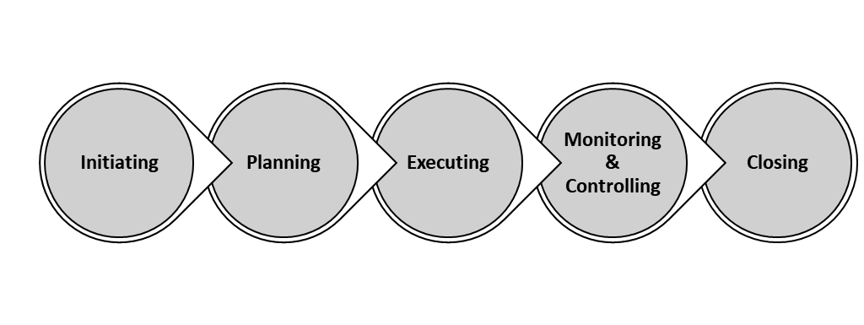
PMI Phases
Project Management Institute (PMI) defines
5 phases of a Project:
Conception and initiation
Planning
Execution
Performance Monitoring/controlling
Project Closing

Slide 23
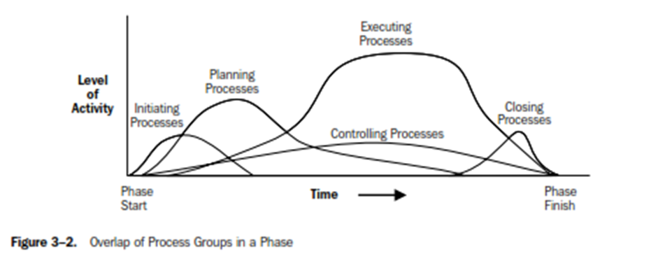

Slide 24

Initiation / Concept Phase
This is the start of the project for the project manager, who is responsible for defining the project at a high level.
This usually begins with a business case, feasibility study, cost-benefit analysis and other types of research to determine whether the project is feasible and should or shouldn’t be undertaken.
Stakeholders provide input.
If the project is approved, then a project charter is created, which provides an overview of the project and sets up the stage for your project plan.

Slide 25
Initiation / Concept Phase …… contd
Undertaking a feasibility study: Identify the primary problem your project will solve and whether your project will deliver a solution to that problem
Identifying scope: Define the depth and breadth of the project
Identifying deliverables: Define the product or service to provide
Identifying project stakeholders: Figure out whom the project affects and what their needs may be
Developing a business case: Use the above criteria to compare the potential costs and benefits for the project to determine if it moves forward
Developing a statement of work: Document the project’s objectives, scope, and deliverables that you have identified previously as a working agreement between the project owner and those working on the project

Slide 26
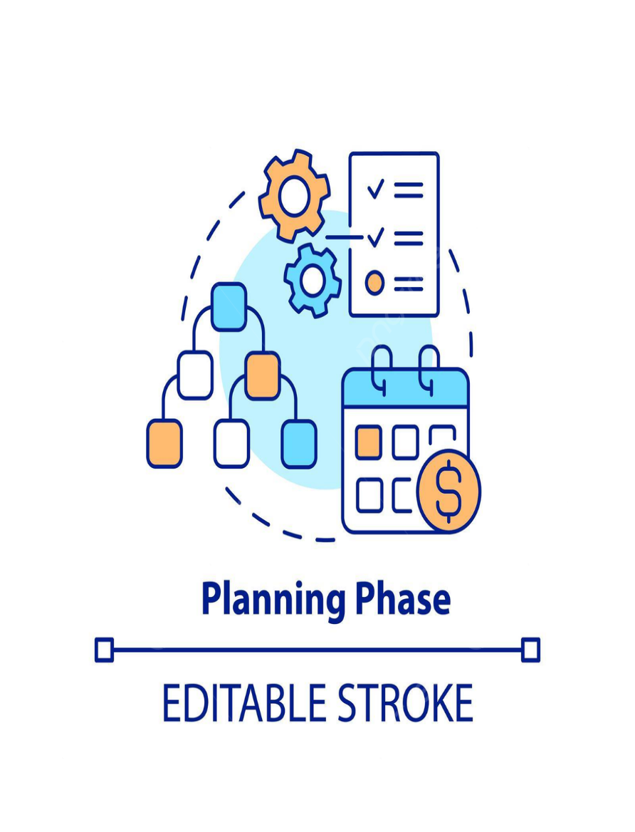
Planning Phase
During this phase of the project management life cycle, larger project is broken down into smaller tasks.
Build teams accordingly for the tasks
Prepare a schedule for the completion of assignments.
Create smaller goals within the larger project, making sure each is achievable within the time frame. Smaller goals should have a high potential for success.

Slide 27
Planning Phase
Creating a project plan:
Identify the project timeline, including the phases of the project, the tasks to be performed, and possible constraints
Creating workflow diagrams:
Visualize your processes using swimlanes to make sure team members clearly understand their role in a project
Estimating budget and creating a financial plan:
Use cost estimates to determine how much to spend on the project to get the maximum return on investment
Gathering resources:
Build your functional team from internal and external talent pools while making sure everyone has the necessary tools (software, hardware, etc.) to complete their tasks
Anticipating risks and potential quality roadblocks:
Identify issues that may cause your project to stall while planning to mitigate those risks and maintain the project’s quality and timeline
Holding a project kickoff meeting:
Bring your team on board, outline the project so they can quickly get to work

Slide 28
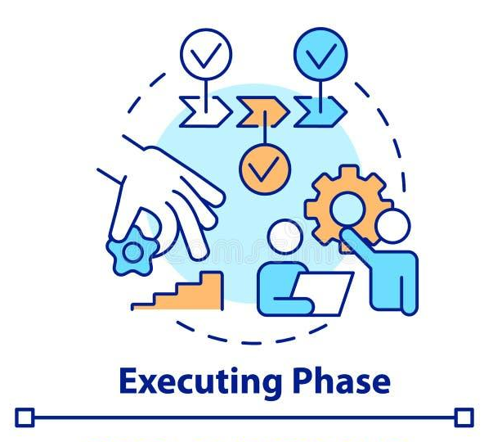
Execution Phase
The execution phase turns your plan into action.
The project manager’s job in this phase of the project management life cycle is to keep
work on track
organize team members
manage timelines
and make sure the work is done according to the original plan.

Slide 29
Execution Phase
Creating tasks and organizing workflows: Assign granular aspects of the projects to the appropriate team members, making sure team members are not overworked
Briefing team members on tasks: Explain tasks to team members, providing necessary guidance on how they should be completed, and organizing process-related training if necessary
Communicating with team members, clients, and upper management: Provide updates to project stakeholders at all levels
Monitoring quality of work: Ensure that team members are meeting their time and quality goals for tasks
Managing budget: Monitor spending and keeping the project on track in terms of assets and resources

Slide 30

Monitoring & Control Phase
This stage usually runs concurrently with Execution stage
Works with teams to resolve any issues
Monitor problems against the original plan and take corrective actions when necessary’
Monitor progress against key performance indicators (KPI) or critical success factors (CSF)
Questions to ask during the performance and monitoring phase:
How is the quality of the project?
Where are we in terms of budget?
Are we on schedule?
Are there any roadblocks?
Are we still projected to meet the deadline?

Slide 31
Monitoring & Control Phase
Key Steps for Project Monitoring And Controlling:
Cost & time management: Review timesheets and expenses to record, control, and track against the project’s budget, timeline, and tasks
Quality management: Reviewing project deliverables and ensuring they meet the defined acceptance criteria
Risk management: Monitor, control, manage, and mitigate potential risks and issues
Acceptance management: Conduct user acceptance testing and create a reviewing system, ensuring that all deliverables meet the needs of the client
Change management: When the project doesn’t go to plan, managing the process of acceptable changes with the client to ensure they’re happy with necessary changes

Slide 32
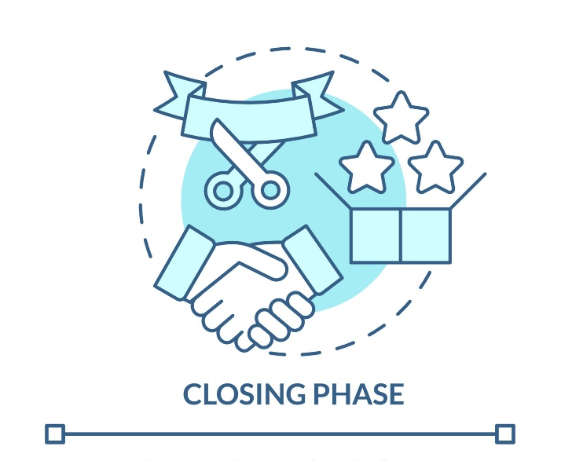
Transfer Phase
Also called project closure.
In the closure phase, you provide final deliverables, release project resources, and determine the success of the project.
Just because the major project work is over, that doesn’t mean the project manager’s job is done—there are still important things to do, including evaluating what did and did not work with the project.

Slide 33
Transfer Phase
Analyzing project performance: Determine whether the project's goals were met (tasks completed, on time and on budget) and the initial problem solved using a prepared checklist.
Analyzing team performance: Evaluate how team members performed, including whether they met their goals along with timeliness and quality of work
Documenting project closure: Make sure that all aspects of the project are completed with no loose ends remaining and providing reports to key stakeholders
Conducting post-implementation reviews: Conduct a final analysis of the project, taking into account lessons learned for similar projects in the future
Accounting for used and unused budget: Allocate remaining resources for future projects

Slide 34
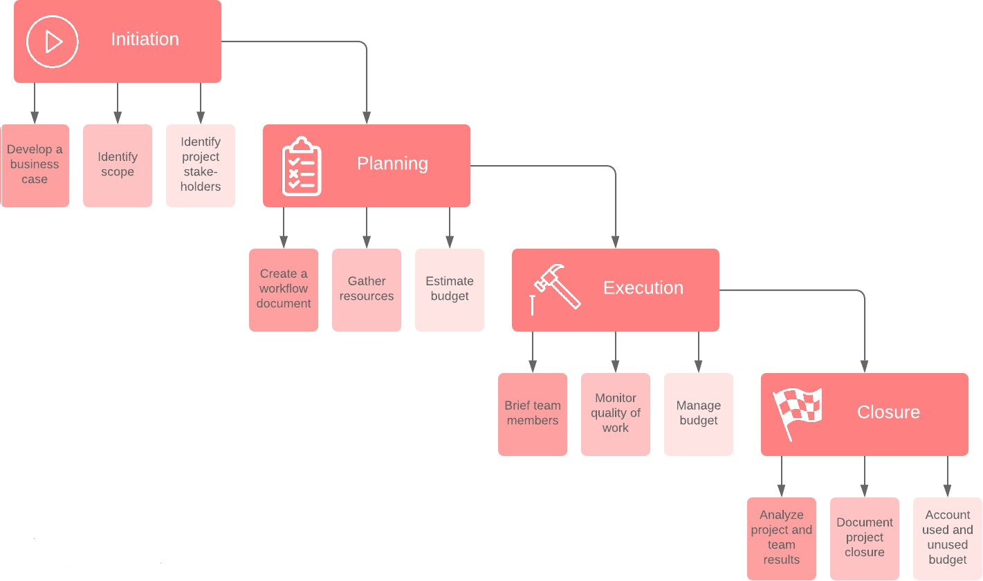
Life Cycle: Software Project Management

Slide 35
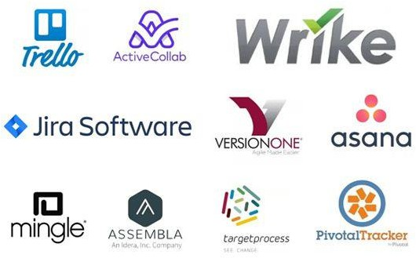
Different Project Management Tools

Slide 36
Any Questions?

Slide 37
Thank You!

